Slide 1
BoneFusionNet: A Detection-Guided Multimodal DeepLearning Framework with Clinical Metadata Fusion for Bone Tumor Classification on Radiographs
B.Sc. Final-Defense
Md. Mohayminul Mukit
ID : 0242220005101570
And
Md. Sadibul Hasan Sadib
ID : 0242220005101563
Department of CSE
Daffodil International University

Slide 2
Outline
Introduction
Background Study
Gap Analysis
Objective
Novelty of this Study
Datasets, Tools and Techniques
Methodology
Results & Analysis
Model Performance Visualization
System Interface
Conclusion & Future Work
References
B.Sc. Final-Defense

Slide 3
Introduction
BoneFusionNet is a deep learning-based framework for automated bone tumor classification using plain radiographs. It integrates automatic tumor detection, ROI-based classification, multimodal fusion, and explainable AI into a unified pipeline. The proposed framework delivers reliable and interpretable predictions for clinical decision support.
B.Sc. Final-Defense

Slide 4
Background Study
Author(s) & Year | Paper Title (Standardized) | Key Contributions / Work Details
Song et al., 2024 | Multimodal Transformer for Bone Tumor Classification (PBTC-TransNet) | Proposed multimodal fusion using X-ray, CT, MRI and clinical data; achieved strong AUC (~0.78 external) and improved clinical applicability
Xu et al., 2024 | Deep Learning-Based Detection of Primary Bone Tumors | Developed detection model on radiographs; outperformed junior radiologists and showed strong localization capability
Wang et al., 2025 | Deep Learning Models for Bone Tumor Classification | Compared multiple DL models (CNN, Transformer); showed strong performance but highlighted misclassification challenges
Bokhari et al., 2026 | Deep Learning Radiographic Classification of Bone Tumors | Multi-class classification (9 tumor types); demonstrated advanced DL architectures for complex classification tasks
Papageorgiou et al., 2025 | YOLO-Based Bone Tumor Detection & Classification | Applied YOLO for end-to-end detection + classification on radiographs; showed scalability and real-time potential
B.Sc. Final-Defense

Slide 5
Background Study
Author(s) & Year | Paper Title (Standardized) | Key Contributions / Work Details
Kaczmarczyk et al., 2025 | Vision-Language Models for Automatic Bone Tumor Recognition on Radiographs | Applied vision-language models for bone tumor recognition; improved multimodal understanding and diagnostic performance.
Zimbalist et al., 2024 | Deep Learning-Based Bone Lesion Detection on Radiographs | Developed a robust lesion detection framework using deep learning; achieved high detection accuracy on radiographs.
Gitto et al., 2024 | AI-Based Bone Tumor Imaging: Current Advances and Clinical Applications | Reviewed AI advances in bone tumor imaging, covering detection, segmentation, classification, and future challenges.
Hinterwimmer et al., 2024 | Recommender-Based Bone Tumor Classification with Radiographs | Proposed an explainable recommender-based framework for multi-class bone tumor classification using radiographs.
B.Sc. Final-Defense

Slide 6
Gap Analysis
Feature | Existing CNN-Based Research | Existing Detection Based Research | Existing Multimodal Research | Proposed BoneFusionNet
Annotation-Free Inference | No | Partial | No | Yes
Patient-Level Data Partitioning | No | No | Partial | Yes
Probability Calibration and Threshold Optimization | No | No | No | Yes
Clinical Metadata Integration | No | No | Partial | Yes
End-to-End Detection + Classification | No | Partial | No | Yes
Explainable AI Integration | Partial | No | Partial | Yes
Deployment Consistent Pipeline | No | Partial | Partial | Yes
Multimodal Fusion | No | No | Yes | Yes
Small Lesion Detection Capability | No | Partial | No | Partial
B.Sc. Final-Defense

Slide 7
Objective
Develop a detection-guided pipeline for tumor localization
Build a deep learning model for benign vs malignant classification
Integrate clinical metadata using multimodal fusion (FusionNet)
Apply calibration techniques for reliable probability outputs
Ensure patient-level, leakage-free evaluation
Improve diagnostic accuracy and reduce false positives
B.Sc. Final-Defense

Slide 8
Novelty of the Work
01
02
03
Detection-guided pipeline without manual annotations
Multimodal fusion of radiographs + clinical metadata (FusionNet)
End-to-end integration of detection, classification, and fusion
04
05
06
(Grad-CAM++, IG) for clinical trust
Probability calibration for reliable predictions
Patient-level, leakage-free evaluation for realistic performance
ADI +20% · MUS +20% · STR -13%
B.Sc. Final-Defense

Slide 9
Dataset, Tools & Techniques
Dataset
Techniques
BTXRD Radiograph Dataset including-
Bone X-ray images (Benign, Malignant, Normal)
Tumor bounding box annotations
Clinical metadata (age, gender, location etc)
Multi-center
Faster R-CNN for tumor detection
ConvNeXt-Tiny-SE for classification
Multimodal Fusion (FusionNet)
StratifiedGroupKFold (patient-level split)
Explainability (Grad-CAM++, Integrated Gradients)
Tools
PyTorch, Detectron2 (model development)
Scikit-learn (metadata modeling, calibration)
Streamlit (web interface)
Kaggle GPU (Tesla T4) environment
B.Sc. Final-Defense

Slide 10
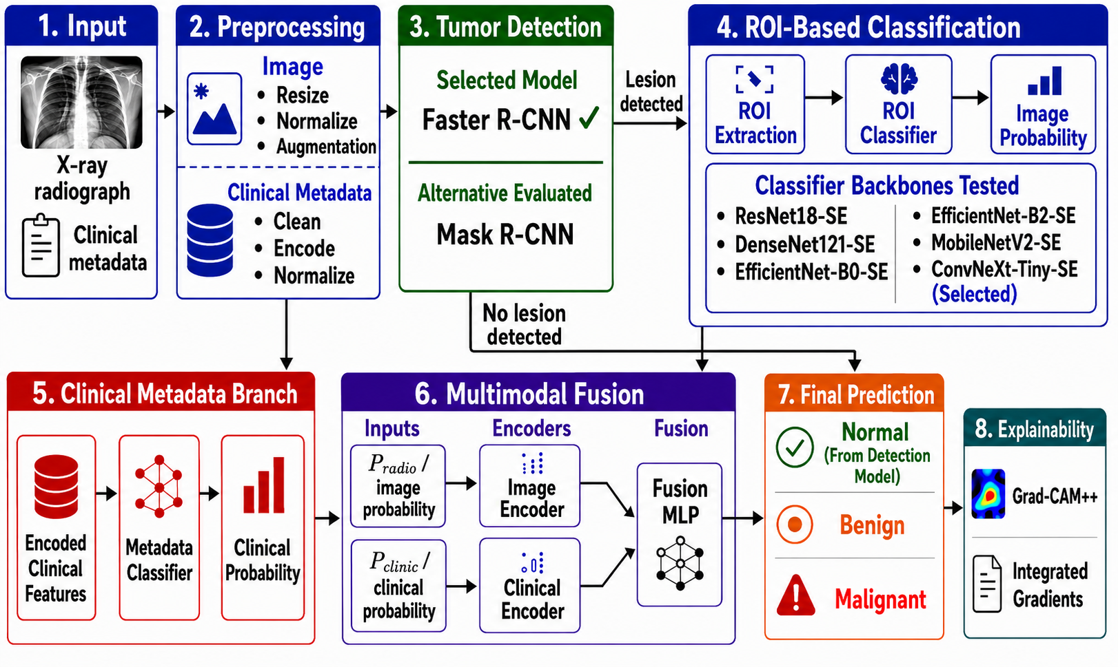
Methodology
Figure 1. Overview of the Proposed BoneFusionNet Framework
B.Sc. Final-Defense

Slide 11
Result and Analysis
Table 1. Test Set Performance Comparison of Baseline and Proposed Models
Model | ROC-AUC | PR-AUC | Balanced Acc | MCC | Sensitivity | Specificity
Clinical-Only | 0.581 | 0.257 | 0.516 | 0.025 | 0.488 | 0.545
Image-Only | 0.911 | 0.738 | 0.772 | 0.562 | 0.610 | 0.935
FusionNet (Proposed) | 0.903 | 0.757 | 0.790 | 0.604 | 0.634 | 0.945
Key Finding: FusionNet achieved the most balanced and reliable performance, outperforming clinical-only and improving stability over image-only by reducing false positives.
B.Sc. Final-Defense

Slide 12
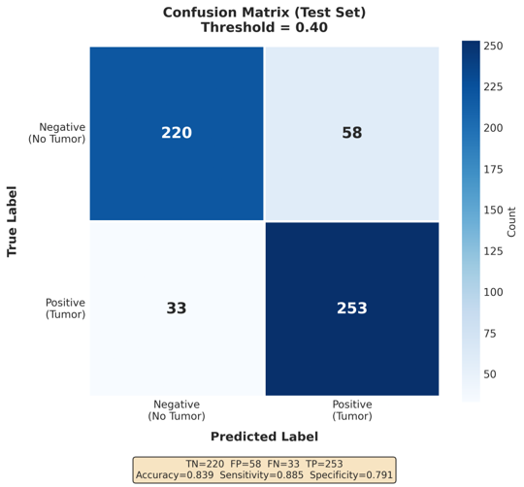
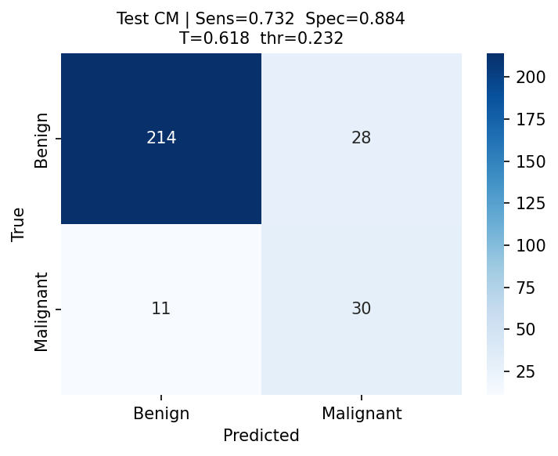
Model Performance Visualization
Figure 2. Test-Set Confusion Matrix of the (a)Detection Model (b) ConvNeXt-Tiny-SE Model
B.Sc. Final-Defense

Slide 13
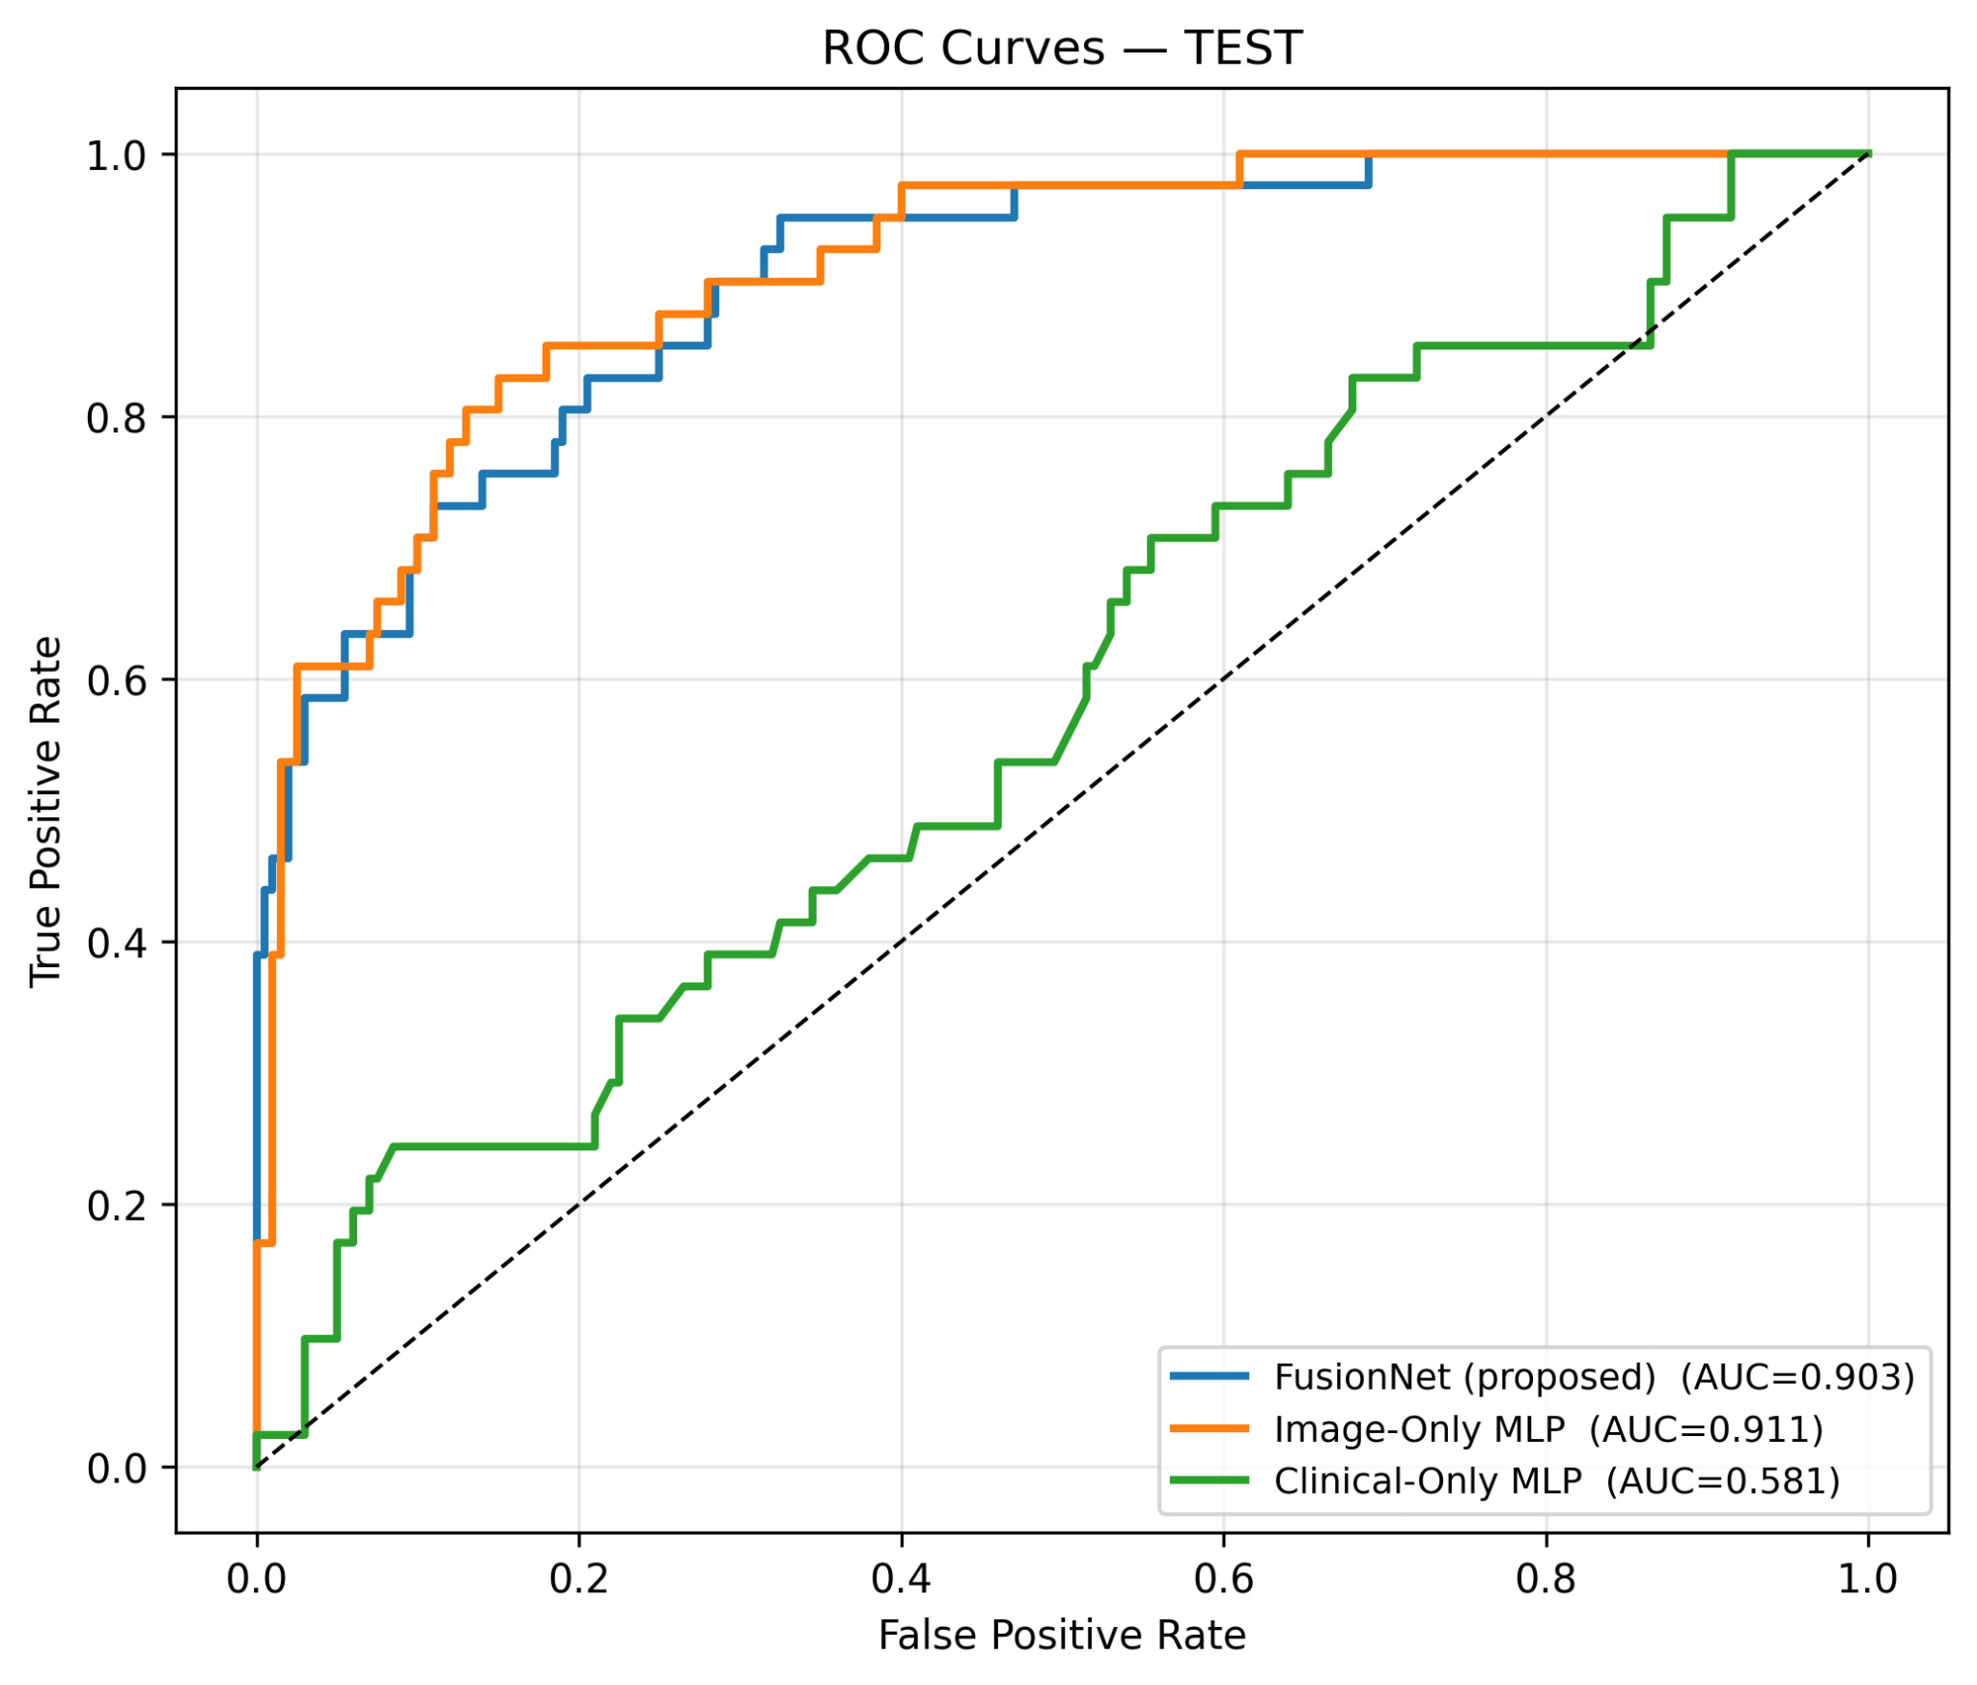
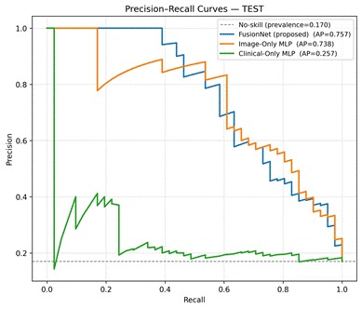
Model Performance Visualization
Figure 2. (a) ROC curve comparison (b) Precision-Recall Curves of fusion models
B.Sc. Final-Defense

Slide 14
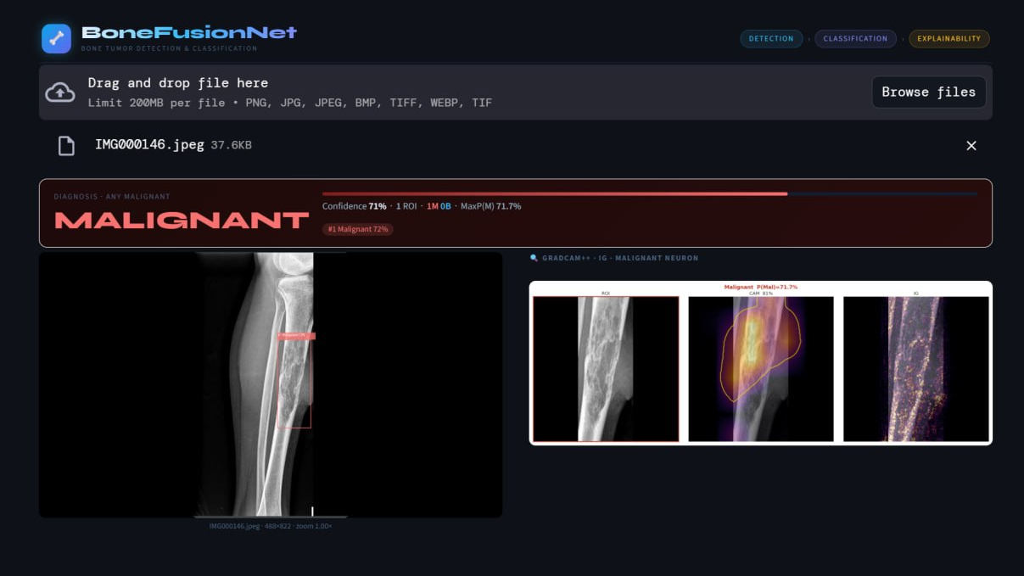
System Interface
Figure 3. Web-based interface of the BoneFusionNet
B.Sc. Final-Defense

Slide 15
Conclusion & Future Work
BoneFusionNet successfully integrates tumor detection, ROI-based classification, multimodal fusion, and explainable AI into a unified framework for automated bone tumor classification. The proposed system achieved reliable performance and produced interpretable predictions for bone tumor classification.
Future Works:
External validation on multi-center datasets.
Improve detection of small and subtle lesions.
Extend to multi-modal imaging (CT/MRI).
Deployment and evaluation in real-world clinical settings.
B.Sc. Final-Defense

Slide 16
References
[1] L. Song et al., “A deep learning model to enhance the classification of primary bone tumors based on incomplete multimodal images in X-ray, CT, and MRI,” Cancer Imaging, vol. 24, Art. no. 135, 2024, doi: 10.1186/s40644-024-00784-7.
[2] D. Xu et al., “Deep learning-based detection of primary bone tumors around the knee joint on radiographs: A multicenter study,” Quantitative Imaging in Medicine and Surgery, vol. 14, no. 8, pp. 5420–5433, 2024, doi: 10.21037/qims-23-1743.
[3] H. Wang et al., “Deep learning models in classifying primary bone tumors and bone infections based on radiographs,” npj Precision Oncology, vol. 9, Art. no. 72, 2025, doi: 10.1038/s41698-025-00855-3.
[4] S. M. Bokhari and M. Shafi, “Deep learning driven radiographic classification of primary bone tumors using attention augmented hybrid models,” Biomedical Signal Processing and Control, vol. 113, Art. no. 108888, 2026, doi: 10.1016/j.bspc.2025.108888.
[5] J. Li et al., “Primary bone tumor detection and classification in full-field bone radiographs via YOLO deep learning model,” European Radiology, vol. 33, pp. 4237–4248, 2023, doi: 10.1007/s00330-022-09289-y.
[6] R. Kaczmarczyk et al., “Application of vision-language models in the automatic recognition of bone tumors on radiographs: A retrospective study,” AI, vol. 6, no. 12, Art. no. 327, 2025, doi: 10.3390/ai6120327.
B.Sc. Final-Defense

Slide 17
References
[7] T. Zimbalist et al., “Detecting bone lesions in X-ray under diverse acquisition conditions,” Journal of Medical Imaging, vol. 11, no. 2, Art. no. 024502, 2024, doi: 10.1117/1.JMI.11.2.024502.
[8] X. Zhou et al., “Emerging applications of deep learning in bone tumors: Current advances and challenges,” Frontiers in Oncology, vol. 12, Art. no. 908873, 2022, doi: 10.3389/fonc.2022.908873.
[9] F. Hinterwimmer et al., “Impact of metadata in multimodal classification of bone tumours,” BMC Musculoskeletal Disorders, vol. 25, Art. no. 822, 2024, doi: 10.1186/s12891-024-07934-9.
[10] S. Yao et al., “A radiograph dataset for the classification, localization, and segmentation of primary bone tumors,” Scientific Data, vol. 12, Art. no. 88, 2025, doi: 10.1038/s41597-024-04311-y.
B.Sc. Final-Defense

Slide 18
THANK YOU
B.Sc. Final-Defense

